Slide 1
Digital Image Processing
IMAGE ENHANCEMENT
Rahul Kumar

Slide 2
Image Enhancement Definition
Image Enhancement: is the process that improves the quality of the image for a specific application

Slide 3
Image Enhancement Methods
Spatial Domain Methods (Image Plane) Techniques are based on direct manipulation of pixels in an image
Frequency Domain Methods Techniques are based on modifying the Fourier transform of the image.
Combination Methods
There are some enhancement techniques based on various combinations of methods from the first two categories

Slide 4
Enhancement Techniques
Frequency Domain Operates on FT of Image
Spatial Operates on pixels

Slide 5
Spatial Domain Methods
•
As indicated previously, the term spatial domain refers to the aggregate of pixels composing an image.
Spatial domain methods are procedures that operate directly on these pixels.
•
•
Spatial domain processes will be denoted by the expression:
g(x,y) = T [f(x,y)]
Where f(x,y) in the input image, g(x,y) is the processed image and T is as operator on f, defined over some neighborhood of (x,y)
In addition, T can operate on a set of input images.
•

Slide 6
TRANSFORMATION (T)
The simplest of T, is when the neighborhood of size 1X1 (that is a form single pixel).
In this case, g depends only on the value of f at (x,y),
•
and T becomes a grey-level (also called intensity or
mapping) transformation function of the form:
s = T (r)
Where, for simplicity in notation, r and s are variables denoting, respectively, the grey level of f(x,y) and g(x,y) at any point (x,y)

Slide 7
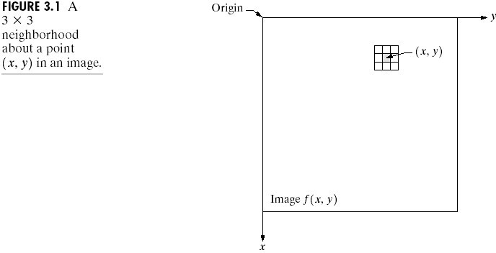

Slide 8
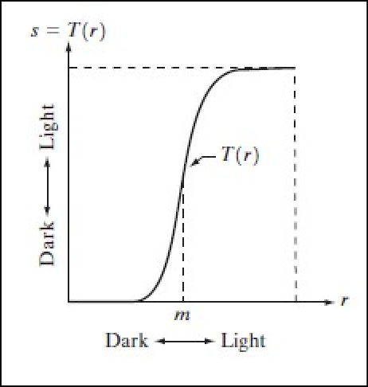
Examples of Enhancement Techniques
•
Contrast Stretching:
If T(r) has the form as shown in the figure below, the effect of applying the transformation to every pixel of f to generate the corresponding pixels in g would:
Produce higher contrast than the original image, by:
Darkening the levels below m in the original image
Brightening the levels above m in the original image
So, Contrast Stretching: is a simple image enhancement technique that improves the contrast
in an image by ‘stretching’ the range of intensity values it contains to span a desired range of values. Typically, it uses a linear function

Slide 9
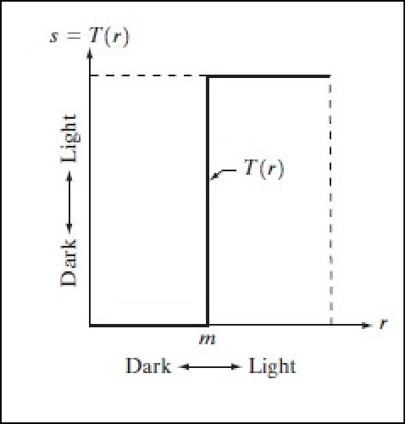
Examples of Enhancement Techniques
•
Thresholding
Is a limited case of contrast stretching, it produces a two-level (binary) image.
Some fairly simple, yet powerful, processing approaches can be formulated with grey-level transformations. Because enhancement at any point in an image depends only on the gray level at that point, techniques in this category often are referred to as point processing.

Slide 10
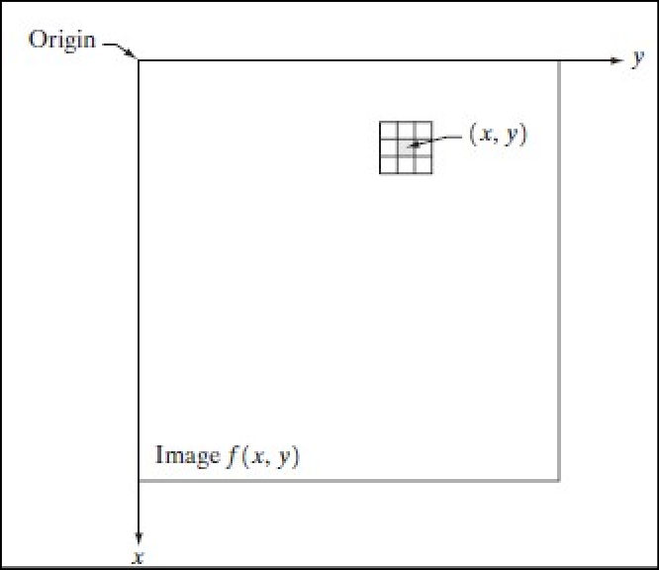
Examples of Enhancement Techniques
Larger neighborhoods allow considerable more flexibility. The general approach is to use a function of the values of f in a predefined neighborhood of (x,y) to determine the value of g at (x,y).
One of the principal approaches in this formulation is based on the use of so-called masks (also referred to as filters)
So, a mask/filter: is a small (say 3X3) 2-D array, such as the one shown in the figure, in which the values of the mask coefficients determine the nature of the process, such as image sharpening.
Enhancement techniques based on this type of approach often are referred to as mask processing or filtering.

Slide 11
Some Basic Intensity (Gray-level) Transformation Functions
•
Grey-level transformation functions (also called, intensity functions), are considered the simplest of all image enhancement techniques.
The value of pixels, before and after processing, will be denoted by r and s, respectively.
These values are related by the expression of the form:
s = T (r)
where T is a transformation that maps a pixel value r into a pixel value s.
•
•

Slide 12
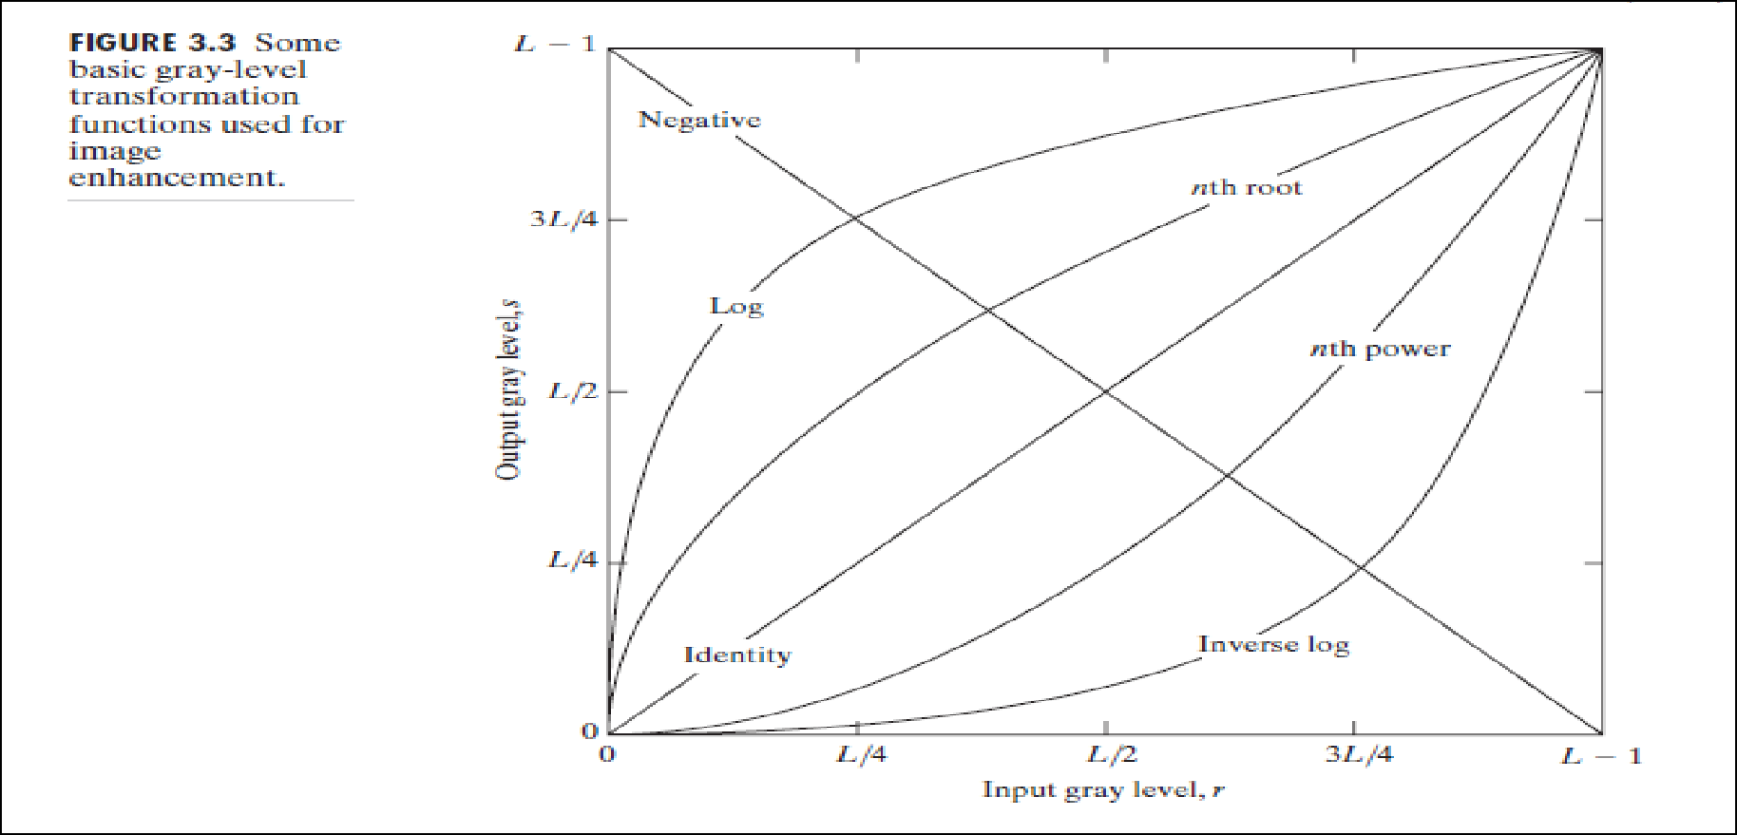
Some Basic Intensity (Gray-level) Transformation Functions
Consider the following figure, which shows three basic types of functions used frequently for image enhancement:

Slide 13
Some Basic Intensity (Gray-level) Transformation Functions
•
The three basic types of functions used frequently for image enhancement:
- Point Transformation:-
Linear Functions:
Negative Transformation
Identity Transformation
Logarithmic Functions:
Log Transformation
Inverse-log Transformation
Power-Law Functions:
n^{th} power transformation
n^{th} root transformation

Slide 14
Point Transformation
S=T(r)
Where T=Transformation Operator And this may be done by using |x| window that means only a single pixel . thus this type of transformation in know as point transformation . In other words basically use of pixel point transformation is masking of a particular pixel

Slide 15
Linear Functions
Identity Function
Output intensities are identical to input intensities
This function doesn’t have an effect on an image, it was included in the graph only for completeness
Its expression:
s = r

Slide 16
Linear Functions
•
Image Negatives (Negative Transformation)
– The negative of an image with gray level in the range [0, L-1], where L = Largest value in an image, is obtained by using the negative transformation’s expression:
s = L – 1 – r
Which reverses the intensity levels of an input image, in this manner produces the equivalent of a photographic negative.
– The negative transformation is suitable for enhancing white or gray detail embedded in dark regions of an image, especially when the black area are dominant in size

Slide 17
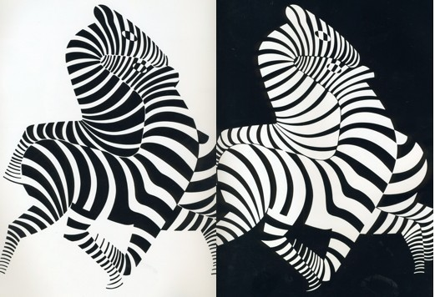
Image Negatives

Slide 18
Logarithmic Transformations
•
Log Transformation
The general form of the log transformation:
s = c log (1+r)
Where c is a constant, and r ≥ 0
Log curve maps a narrow range of low gray-level values in the input image into a wider range of the output levels.
Used to expand the values of dark pixels in an image while compressing the higher-level values.
It compresses the dynamic range of images with large variations in pixel values.

Slide 19
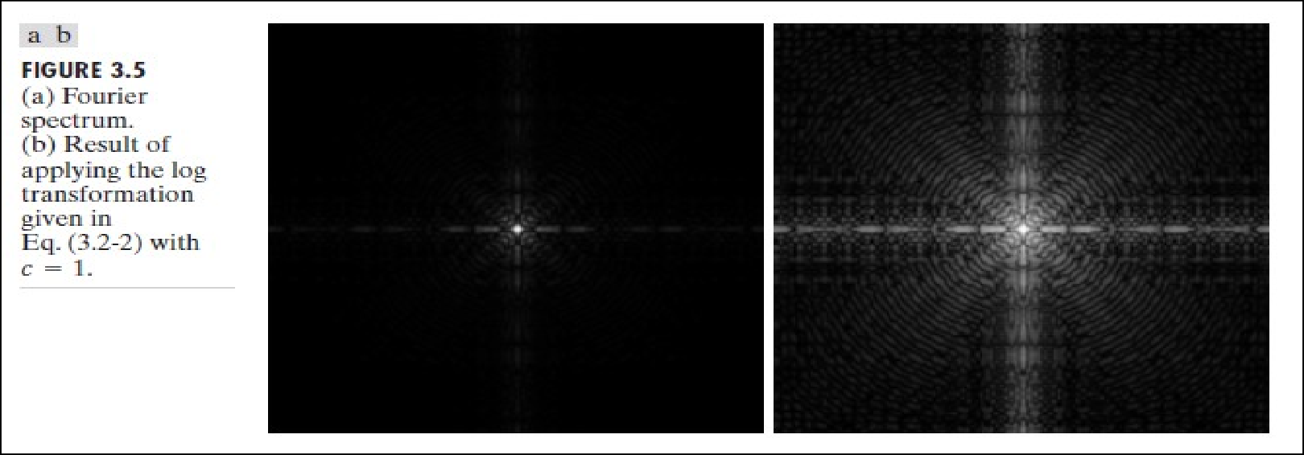
Logarithmic Transformations

Slide 20
Logarithmic Transformations
•
Inverse Logarithm Transformation
Do opposite to the log transformations
Used to expand the values of high pixels in an image while compressing the darker-level values.

Slide 21
Power-Law Transformations
Power-law transformations have the basic form of:
s = c.r^{ᵞ}
Where c and ᵞ are positive constants

Slide 22
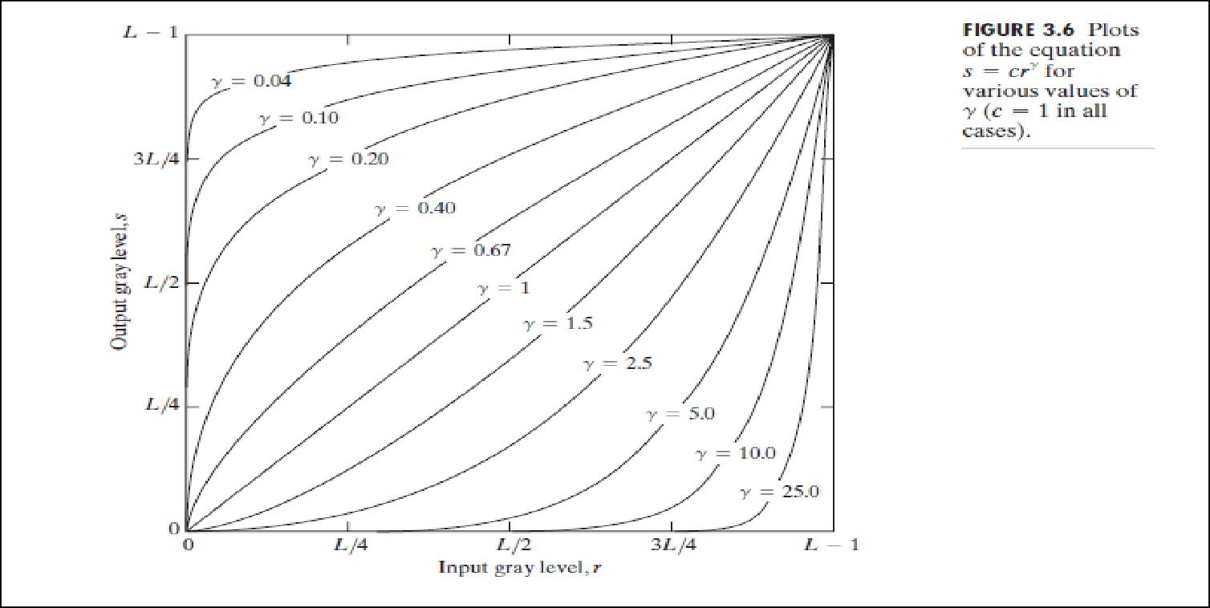
Power-Law Transformations
Different transformation curves are obtained by varying ᵞ (gamma)

Slide 23
Power-Law Transformations
•
Variety of devices used for image capture, printing and display respond according to a power law. The process used to correct this power-law response phenomena is called gamma correction.
For example, Cathode Ray Tube (CRT) devices have an intensity-to- voltage response that is a power function, with exponents varying from approximately 1.8 to 2.5.With reference to the curve for g=2.5 in Fig. 3.6, we see that such display systems would tend to produce images that are darker than intended. This effect is illustrated in Fig. 3.7. Figure 3.7(a) shows a simple gray-scale linear wedge input into a CRT monitor. As expected, the output of the monitor appears darker than the input, as shown in Fig. 3.7(b). Gamma correction. In this case is straightforward. All we need to do is preprocess the input image before inputting it into the
monitor by performing the transformation. The result is shown in Fig. 3.7(c).When input into the same monitor, this gamma-corrected input produces an output that is close in appearance to the original image, as shown in Fig. 3.7(d).

Slide 24
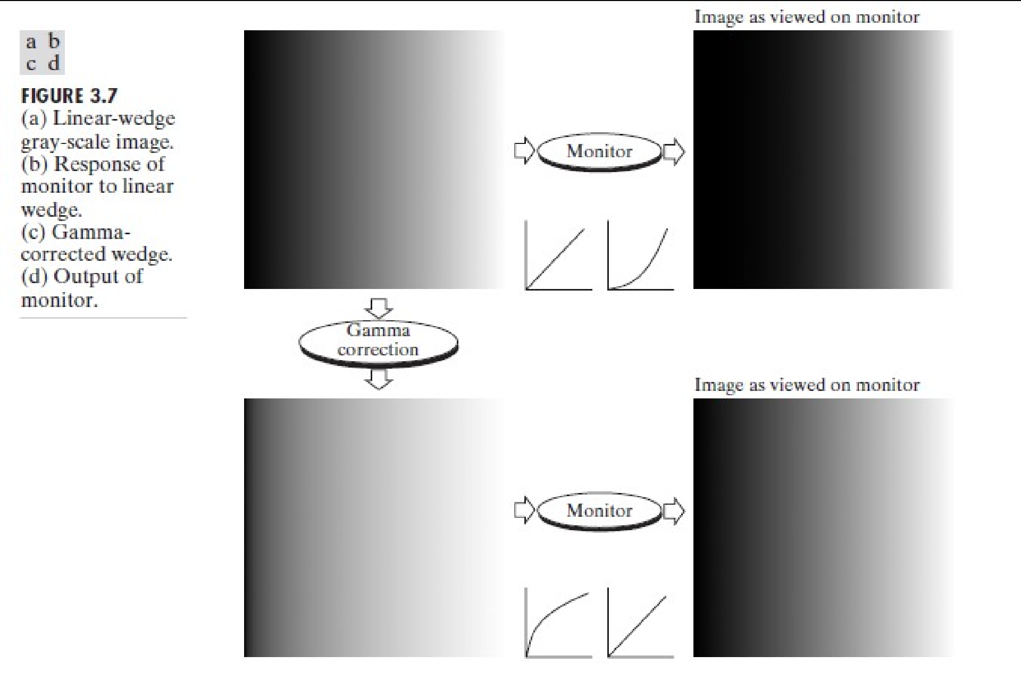
Power-Law Transformation

Slide 25
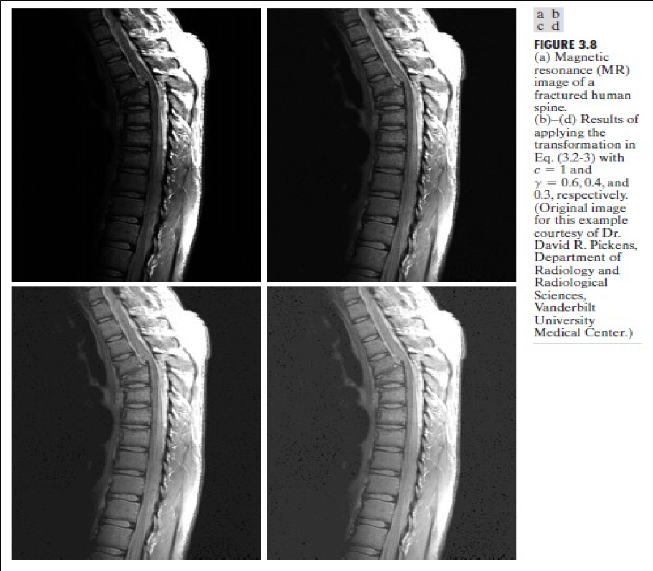
Power-Law Transformation
•
In addition to gamma correction, power-law transformations are useful for
general- purpose
contrast manipulation. See figure 3.8

Slide 26
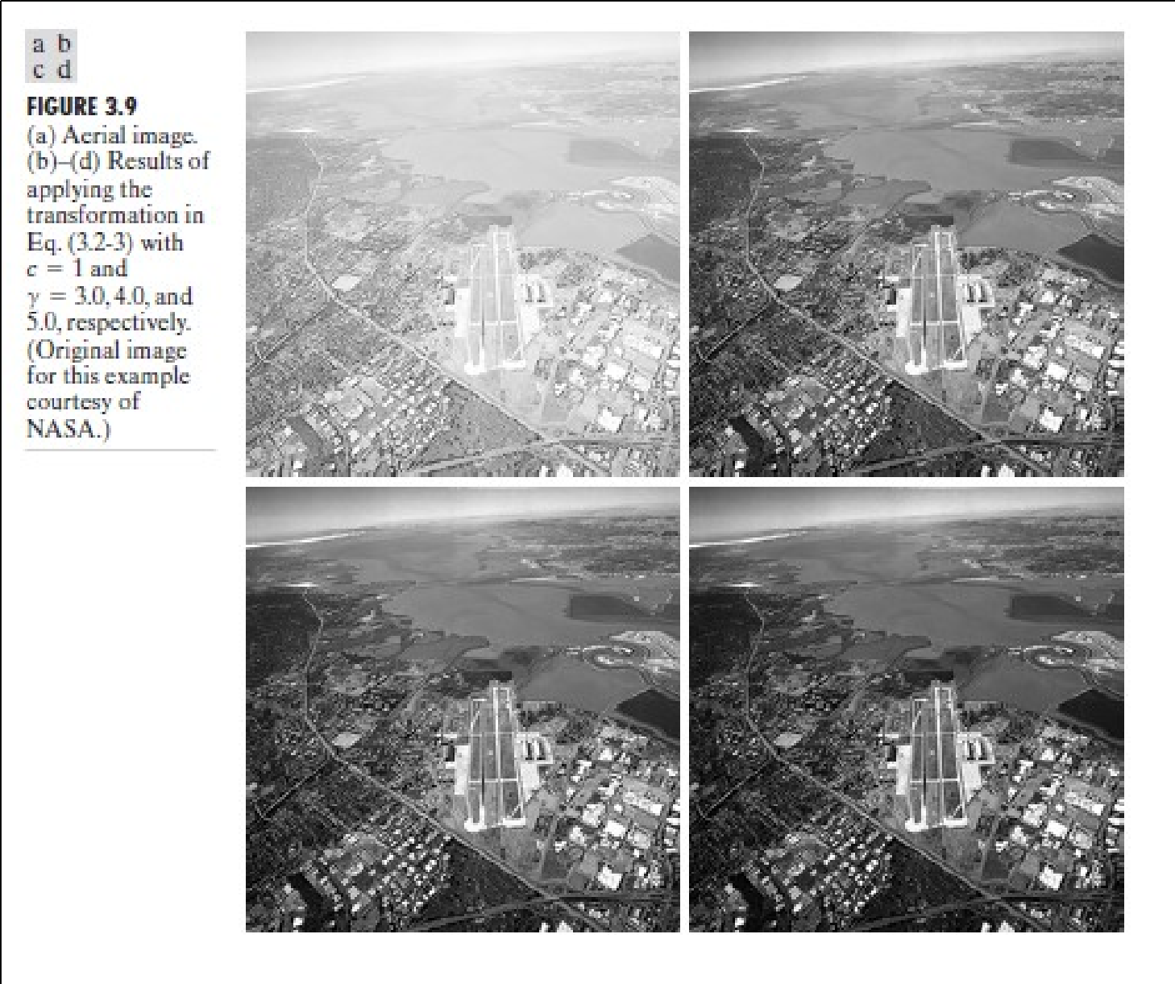
Power-Law Transformation
•
Another illustration of Power-law transformation

Slide 27
Piecewise-Linear Transformation Functions
Principle: Rather than using a well defined mathematical function we can use arbitrary user defined transforms
Advantage: Some important transformations can be formulated only as a piecewise function.
Disadvantage: Their specification requires more user input that previous transformations

Slide 28
Types of Piecewise transformations
Contrast Stretching
Gray-level Slicing
Bit-plane slicing

Slide 29
Contrast Stretching
One of
the simplest piecewise linear is a contrast-stretching
functions
transformation, which is used to enhance the low contrast images.
Low contrast images may result from:
Poor illumination
Wrong setting of lens aperture during image acquisition.

Slide 30
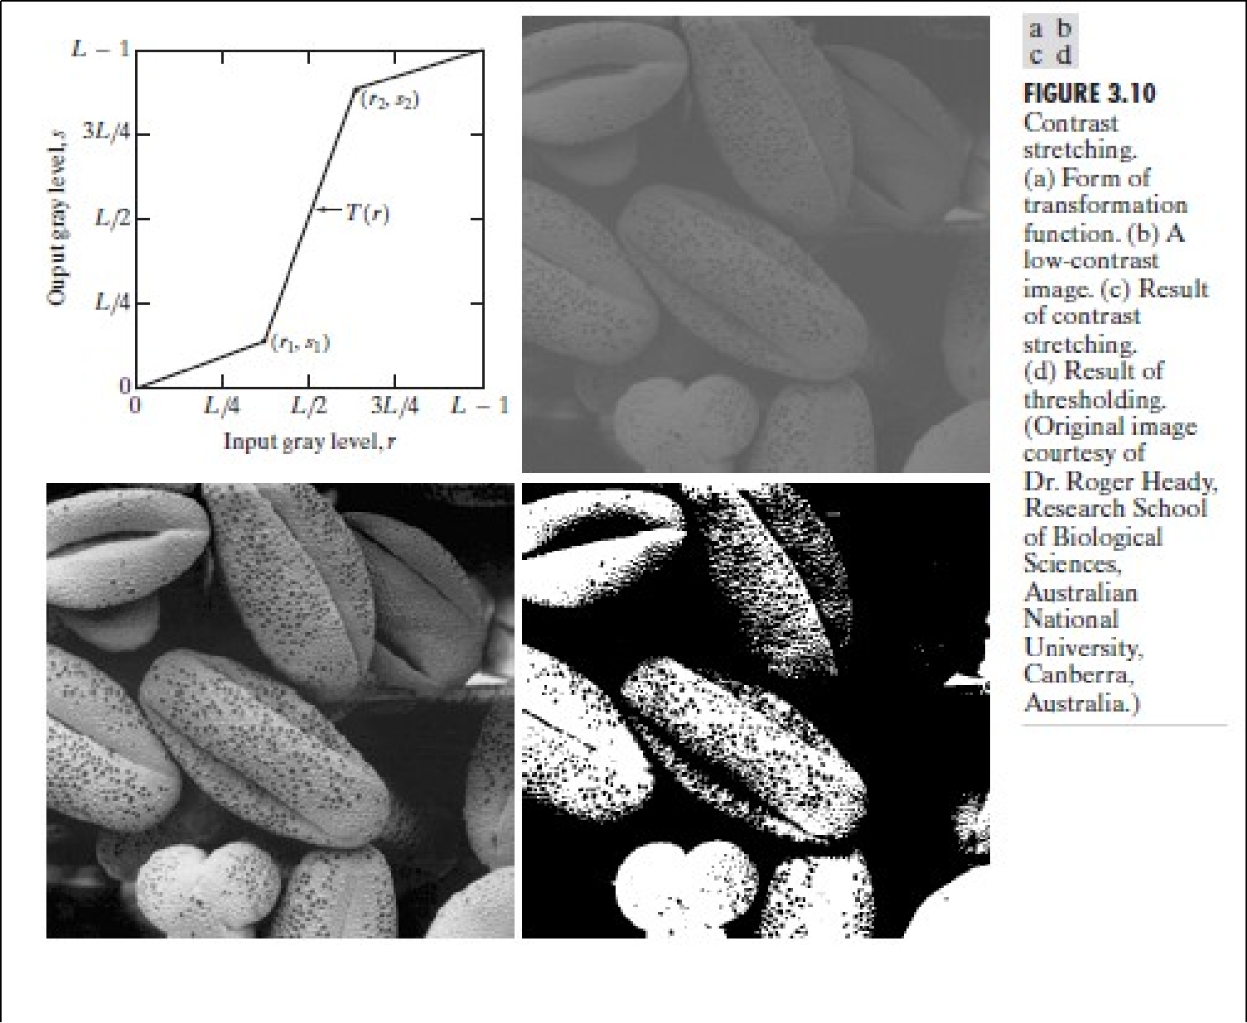
Contrast Stretching

Slide 31
Contrast Stretching
•
Figure 3.10(a) shows a typical transformation used for contrast stretching.
The locations of points (r1, s1) and (r2, s2) control the shape of the transformation function.
If r1 = s1 and r2 = s2, the transformation is a linear function that produces no changes in gray levels.
If r1 = r2, s1 = 0 and s2 = L-1, the transformation becomes a
Thresholding function that creates a binary image.
Intermediate values of (r1, s1) and (r2, s2) produce various degrees of spread in the gray levels of the output image, thus affecting its contrast.
In general, r1 ≤ r2 and s1 ≤ s2 is assumed, so the function is always increasing.
•
•
•
•
•

Slide 32
Contrast Stretching
•
Figure 3.10(b) shows an 8-bit image with low contrast.
•
Fig. 3.10(c) shows the result of contrast stretching, obtained by setting (r1, s1) = (r_{min}, 0) and (r2, s2) = (r_{max},L-1) where r_{min} and r_{max}
denote the minimum and maximum gray levels in the image, respectively. Thus, the transformation function stretched the levels linearly from their original range to the full range [0, L-1].
•
Finally, Fig. 3.10(d) shows the result of using the thresholding function defined previously, with r1=r2=m, the mean gray level in the image.

Slide 33
Gray-level Slicing or Intensity-level Slicing
•
This technique is used to highlight a specific range of gray levels in a given image.
It can be implemented in several ways, but the two basic themes are:
One approach is to display a high value for all gray levels in the range of interest and a low value for all other gray levels. This transformation, shown in Fig 3.11 (a), produces a binary image.
The second approach, based on the transformation shown in Fig 3.11 (b), brightens the desired range of gray levels but preserves gray levels unchanged.
Fig 3.11 (c) shows a gray scale image, and fig 3.11 (d) shows the result of using the transformation in Fig 3.11 (a).
•

Slide 34
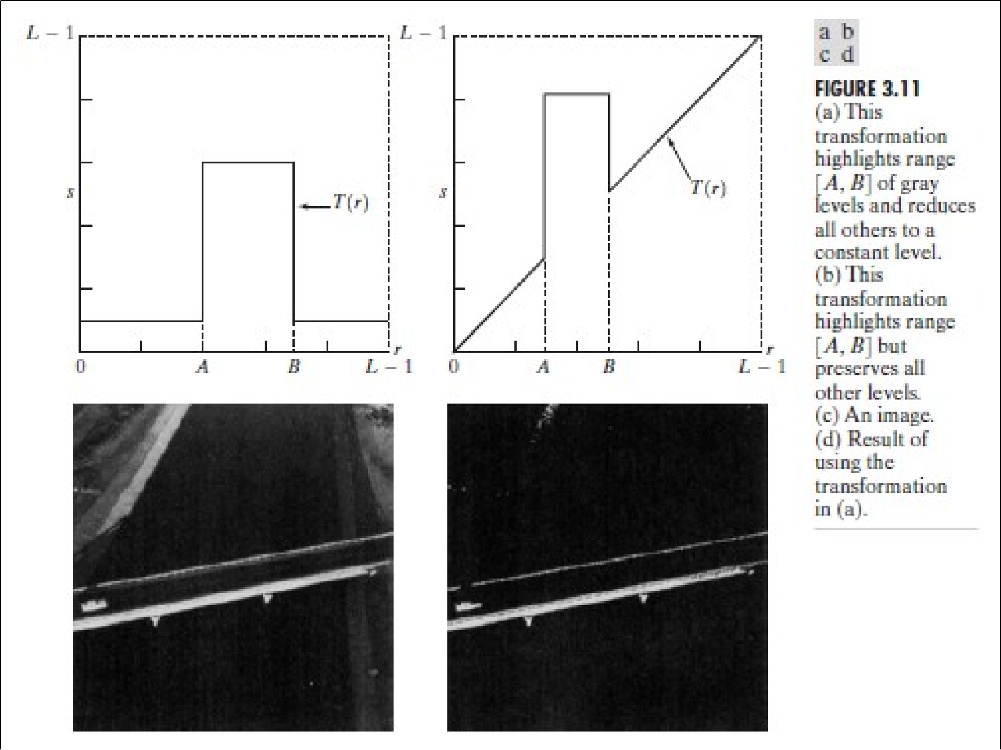
Gray-level Slicing

Slide 35
Bit-plane Slicing
•
•
Pixels are digital numbers, each one composed of bits.
For example, the intensity of each pixel in a 256 gray – scale image is composed of 8 bits (ie 1 byte)
•
Instead of highlighting gray-level range, we could highlight the contribution made by each bit.
This method is useful and used in image compression.
•

Slide 36
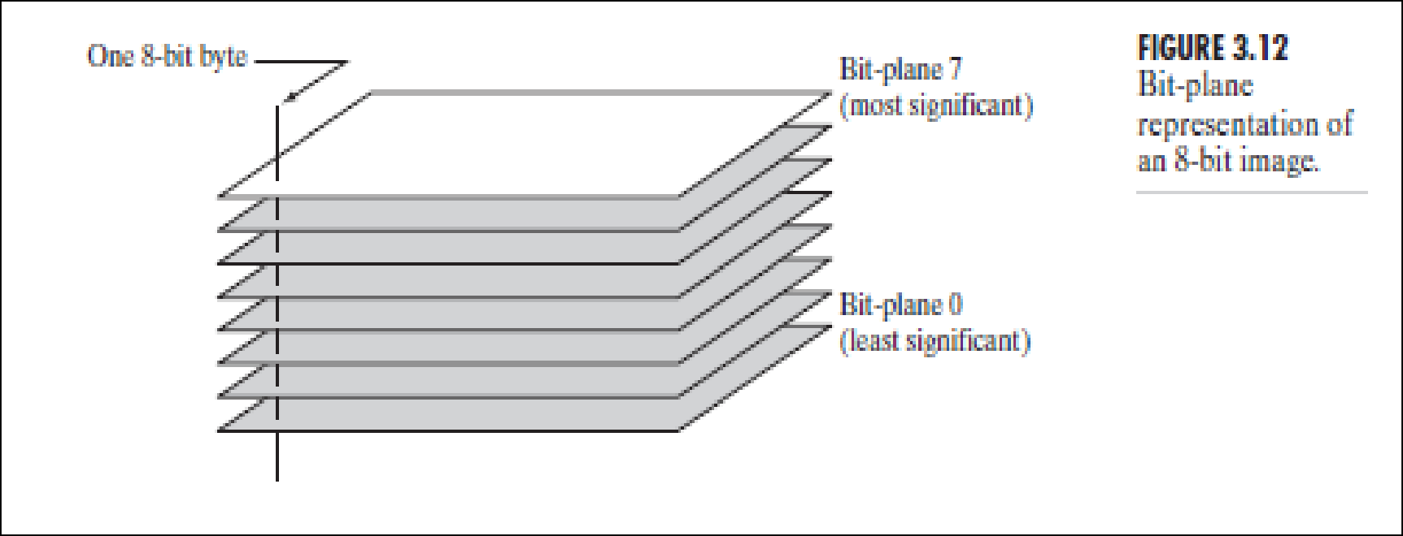
Bit-plane Slicing

Slide 37
Bit-plane Slicing
•
Assuming that each pixel is represented by 8 bits, the image is composed of eight 1-bit planes
Plane 0 containing the lowest order bit of all pixels in the image and plane 7 all the higher order bits
Only the most significant bits contain the majority of visually significant data. The other bit planes constitute the most suitable details
Separating a digital image into its bits planes is useful for analyzing the relative importance played by each bit of the image
It helps in determining the adequacy of the number of bits used to quantize each pixel
•
•
•
•

Slide 38
Image Enhancement Using Arithmetic and Logical Operation.
In arithmetic operation we have two image , one may be real and other one is structuring element . Which is being placed or being operated with the arithmetic operator pixel-by-pixel.
The Arithmetic operation between p and q are denoted as follow.
Addition = p+q
Subtraction =p-q
Multiplication =p*q
Division = p/q
It is performed an whole image by pixels to pixels(just like logical operation).
Basic use of addition is for image averaging to reduce error.
Basic use of subtraction is in medical imaging ,where we have to remove the static background information.
Basic use of multiplication is gray-level modification.

Slide 39
Logical Operation
The Logical operation in the Enhancement are as follow.
AND Operator = p AND q
Or Operator = p or q
Not Operator = p NOT
In Logical Operator we usually use to make an logical operation every pixel-by-pixels according to the truth table of logic gates .

Slide 40
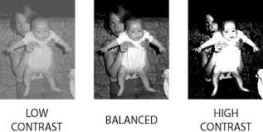
Histogram Equalization
It Is used to enhance the contrast.
Contrast is the difference in color that makes an object distinguishable from other object within the same field of view.
A graph indicating the number of times each gray level occurs in the image . If Fk is the kth gray level and nk is the number of pixel with gray level k then it is histogram is n(nk)=nk

Slide 41
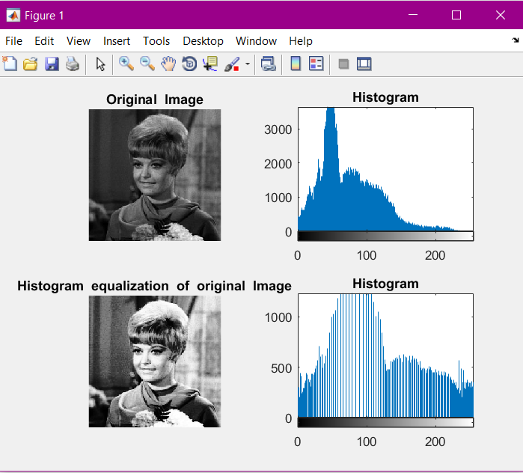
X-axis has gray level and y-axis hs no. of pixel in each gray level .we can also plot histogram with the help of probability of occurance of kth gray level .

Slide 42
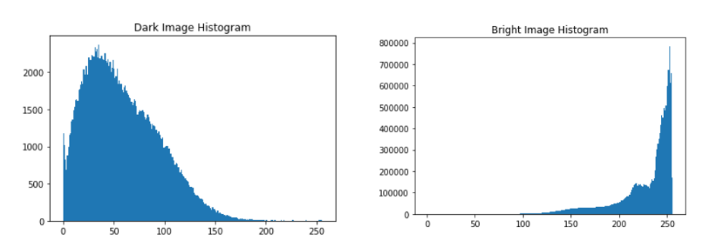

Slide 43
Histogram
Histogram of an image represent the relative frequency occurrence of various grey level in an image .
Technique vary effective .
Useful in many image processing application .
Also use for manipulating contrast & brightness of image .
The quality of image can be control by normalized its histogram to flat profile.
Graphical representation anything
Histogram of image can be plotted in two ways

Slide 44
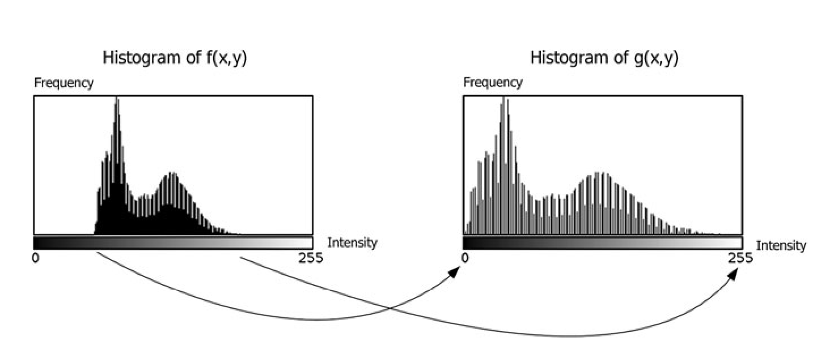
Histogram Stretching
It is used to increase dynamic range.
Here histogram is spread to cove entire dynamic range
It is also known as histogram scaling.
Mapping function for histogram stretching.
Smax-Smin/rmax-rmin
Transformation in given as .
T=Smax-Smin/rmax-rmin(r-rmax)+Smin
Rmin=minimum grey level of input image .
Rmax=maximum grey level of output image .
Smax=maximum pixel value in stretching histogram.
Smin=minimum pixel value in stretching histogram.

